Slide 1
Intro to Databases and Select
Module 2: 01

Slide 2
Objectives
Introduction to Databases
Tables, Rows, and Columns
ANSI-SQL Data Types
SQL Queries: SELECT

Slide 3
Intro to Databases
A database is an organized collection of data that can be accessed, managed, and updated.
A relational database is a particular type of database built upon the relational model of data
Data in a relational database can be accessed and reassembled in many different ways without having to reorganize the data.
Each entity is stored in a table.
Columns are called attributes
Rows represent individual records.
Rows represent individual records and consist of many attributes organized using columns.

Slide 4
(R)DBMS
A Relational Database Management System ( (R)DBMS) is a software application designed to manage a database. It has four basic functions
Data Definition
Data Storage
Data Retrieval
Administration
RDBMSs include databases like Oracle, Microsoft Sql Server, PostgreSQL, MySql, are relational, and are commonly called SQL Databases.
NoSQL Databases are those that do not use a relational structure, instead they structure data specific to the problem they are designed to solve. NoSQL databases include MongoDB, Cassandra, Google BigTable, HBase, DynamoDB, and Firebase

Slide 5
Tables, Columns, Rows
An entity is a set of data being stored a table.
A Table defines a set of data elements and the structure to store them. Tables are structured into columns and rows.
Columns - attributes of a table and define the name and data type. A table has a set number of defined columns.
Rows - the data being stored. A table has an unlimited number or rows.
A Cell is the location where a column and row intersect, and is used to refer to a specific value or row of data (entity).

Slide 6
Column
Tables have a set number.
Define the data the table will hold
id | name | countrycode | district | population
1 | Kabul | AFG | Kabol | 1780000
2 | Qandahar | AFG | Qandahar | 237500
3 | Herat | AFG | Herat | 186800
4 | Mazar-e-Sharif | AFG | Balkh | 127800
5 | Amsterdam | NLD | Noord-Holland | 731200
6 | Rotterdam | NLD | Zuid-Holland | 593321
7 | Haag | NLD | Zuid-Holland | 440900
8 | Utrecht | NLD | Utrecht | 234323
9 | Eindhoven | NLD | Noord-Brabant | 201843
10 | Tilburg | NLD | Noord-Brabant | 193238
Row
Tables have a unlimited number (0...n)
Contain the data
Cell
The intersection of a column and row
Used to identify a specific value or row

Slide 7
ANSI SQL
SQL - Structured Query Language : a language that lets you access and manipulate databases
ANSI-SQL - A standard that databases must follow to be considered a SQL Database.
All SQL databases support the ANSI-SQL language, however, most databases extend it with their own proprietary additions.

Slide 8
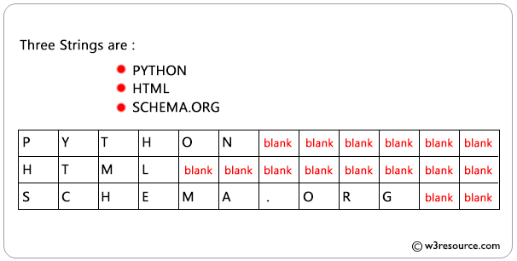
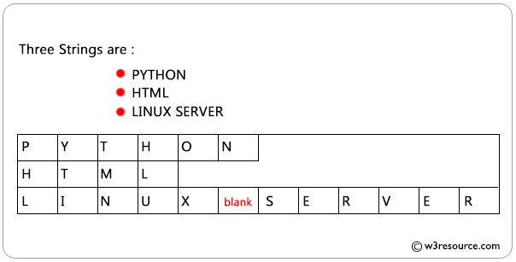
Character Data Types
String literals in SQL use single quotes: ‘Hello’
char(#) - character. # defined the length of the data.
varchar(#) - varying character. # defined the length of the data.
text - text based data that is not limited by a predefined size
char(12)
varchar(12)

Slide 9
Numeric Data Types
int or integer - similar to Java’s int
bigint - Big Integer, similar to Java’s long
decimal(p, s) - floating point numbers, similar to Java’s double or BigDecimal
p - precision - the total number of digits being stored
s - scale - number of digits to the right of the decimal point
1234.567 has a precision of 7 1234.567 has a scale of 3
There are other numeric data types that specific to each RDMS. This is just a basic list of the ANSI types and not representative of every numeric data type.

Slide 10
Other Data Types
boolean - true/false
Not the same in all SQL databases
Mysql - tinyint(1)
PostgreSQL / Oracle - boolean
MS Sql - bit
DATE
yyyy-mm-dd
TIME
hh:mm:ss
TIMESTAMP / DATETIME
yyyy-mm-dd hh:mm:ss
Date and Time datatypes also support the usage of 24-hour vs 12-hour clocks and Time Zones.

Slide 11
Setting up the World Database
In terminal, CD to the directory with the world.sql file
yourname-java-blue/module-2/01_Introduction_to_Databases/student-lecture/database
Create the Database - password: postgres1
psql -U postgres -c “CREATE DATABASE world”
Load the structure and data
psql -U postgres -d world -f world.sql

Slide 12
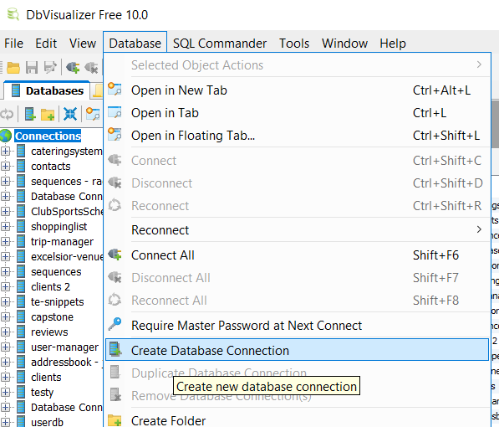
Connecting to the World Database in DBVisualizer
From the top menu select
Database -> Create Database Connection

Slide 13
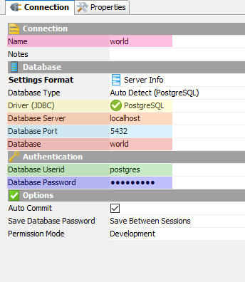
World Connection Settings
Name | Name for the connection, used by DbVisualizer in connection menus to refer to these settings
Notes | Leave blank
Settings Format | Use default settings
Database Type | Use default settings
Driver (JDBC) | PostgreSQL
Database Server | localhost
Database Port | 5432
Database | The name of the database in Postgres. This must match the database name used when you ran createdb to create the database.
Database Userid | postgres
Database Password | postgres1
Use default settings
Select to Manually configure the connection

Slide 14
Structured Query Language (SQL)
A declarative programming language used to manage a database and its data.
Consists of 3 sub-languages
DDL - Data Definition Language - defines the structure of the data
DML - Data Manipulation Language - query and modify the data
DCL - Data Control Language - used to administer the database
A declarative programming language specifics what actions should be performed rather than how to perform those actions.

Slide 15
SELECT
The SELECT clause indicates what columns that you want to get from a database table.
The FROM clauses indicates which table(s) to retrieve the data from.
SELECT name, population FROM country;
DISTINCT can be used with a column name to return only unique values.
SELECT DISTINCT name
FROM city;
AS can be used with a column name to give it an Alias (new name)
SELECT name AS ‘CityName’
FROM city;
Or to give a name to a combines result:
SELECT ( col1 + col2 ) AS ‘Sum’
* can be used to select all columns from a table.
SELECT * FROM country;

Slide 16
WHERE
The WHERE clause is used to filter the rows returned in the results using conditional clauses.
SELECT name, population FROM country WHERE population > 100000000;

Slide 17
WHERE Clause Conditionals
Conditionals can be chained together using AND and OR.
Precedent can be set using ()
Example:
WHERE num > 5 AND (name LIKE ‘A%’
OR name LIKE ‘B%’)
= | equal to
!=, <> | Not equal to
>, <, >=, <= | Greater/Less Than
IS NULL | value is null
IS NOT NULL | value is not null
IN (val1, val2, …) | Value is IN the list
NOT IN (val1, val2, …) | Value is NOT IN the list
BETWEEN va1 AND val2 | The value is between the 2 values Example: number BETWEEN 2 AND 10;
LIKE (%) | The value matches a pattern created with % Example: a% - the value starts with a %a - the value ends with a %a% - the value contains an a
Strings in SQL use single quotes.
name = ‘John’

